Slide 1


Bias Analysis of the COMPAS Dataset
Presented to you by: Cyber Ninjas
Bias Audit Report
LINK:auditReport.ipynb - Colab

Slide 2
Objectives
KEY BIAS PATTERNS DISCOVERED
MITIGATIONS STRATEGIES IMPLEMENTED
REAL WORLD IMPLICATIONS
RECOMMENDATIONS FOR STAKEHOLDERS
CONCLUSION

Slide 3
KEY POINTS
COMPAS (Correctional Offender Management Profiling for Alternative Sanctions) used nationwide to assess defendant's recidivism risk
ProPublica's 2016 investigation found significant racial bias
Black defendants were:
  More likely to be falsely labeled high-risk
  Less likely to be falsely labeled low-risk
Real-world impact: Affects bail decisions, sentencing, and lives

Slide 4
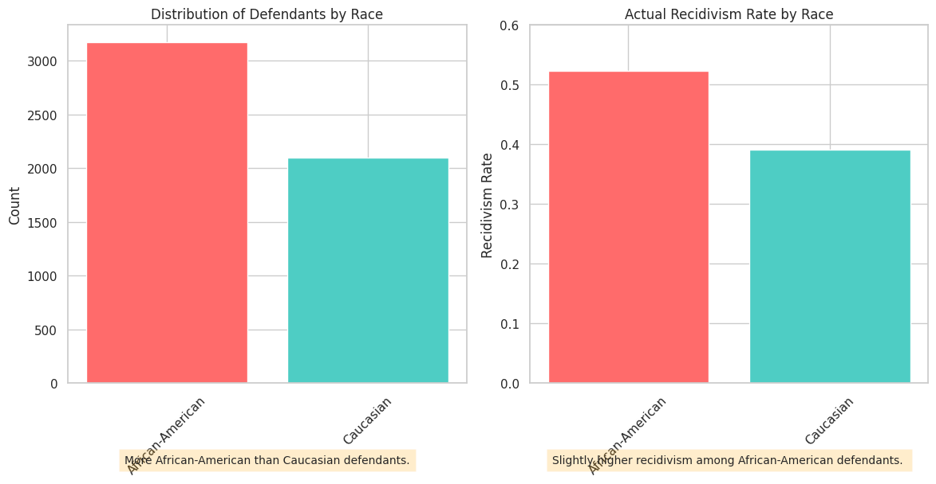
KEY BIAS PATTERNS
African-American defendants are overrepresented
Slightly higher actual recidivism rate for African-Americans
Baseline for fairness evaluation

Slide 5
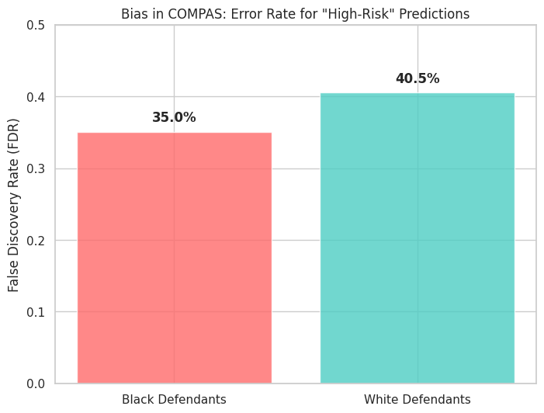
KEY BIAS PATTERNS: ERROR RATE DISPARITIES
FALSE DISCOVERY RATE(FDR)HIGHER FOR BLACK DEFENDANTS
INDICATES MORE FALSE HIGH-RISK PREDICTIONS FOR AFRICAN-AMERICANS.
HIGHLIGHTS DISPARITIES IN PREDICTIVE ERRORS

Slide 6
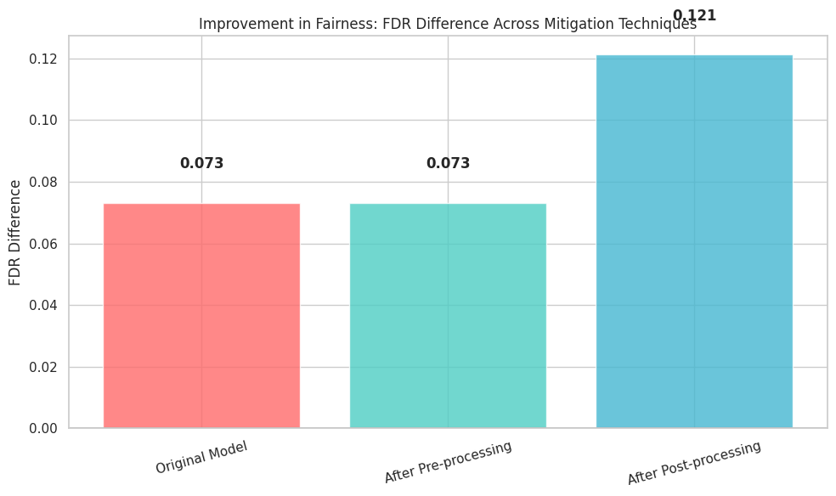
Bias mitigation techniques
PRE-PROCESSING: REWEIGHING TRAINING DATA. 0.625 -0.164 -0.087 0.073 2
POST-PROCESSING: EQUALIZED ODDS ADJUSTMENT. 0.590 -0.020 0.003 0.121
BOTH REDUCE BIAS; MINIMAL ACCURACY TRADE-OFF

Slide 7
IMPACT OF BIAS
LOSS OF LIBERTY DUE TO BIASED RISK SCORES
SELF-FULFILLING PROPHECY AFFECTING EMPLOYMENT & HOUSING
EROSION OF TRUST IN THE JUSTICE SYSTEM
RISK OF OVER-RELIANCE ON ALGORITHMS

Slide 8
Recommendations / Ethics Framework
Five Principles for Ethical Deployment:
Justice & Fairness - Mandatory pre-deployment audits
Transparency & Explainability - Understandable score explanations
Human Oversight - Algorithms as support tools, not decision-makers
Proportionality - Restrict use to appropriate contexts
Remediation - Accessible challenge processes

Slide 9
CONCLUSION
Bias is Quantifiable - We can measure algorithmic discrimination
Mitigation is Possible - Technical solutions exist but have limits
Trade-offs are Real - Fairness often comes at accuracy cost
Technical + Structural - Need both algorithmic and systemic solutions
Ongoing Process - Fairness requires continuous monitoring and improvement

